Slide 1
Microwave Engineering

Slide 2
Lecture Contents
History
Introduction to Microwaves
Properties of Microwaves
Advantages/Disadvantages of Microwaves
Waveguide
Applications of Microwaves
Microwave oven
Radar
Wireless Mobile Charging
Others Applications

Slide 3
Brief Microwave History
Maxwell (1864-73)
integrated electricity and magnetism
set of 4 coherent and self-consistent equations
predicted electromagnetic wave propagation
Hertz (1886-88)
experimentally confirmed Maxwell’s equations
oscillating electric spark to induce similar oscillations in a distant wire loop (λ=10 cm)

Slide 4
Brief Microwave History
Marconi (early 20th century)
parabolic antenna to demonstrate wireless telegraphic communications
tried to commercialize radio at low frequency
Lord Rayleigh (1897)
showed mathematically that EM wave propagation possible in waveguides
George Southworth (1930)
showed waveguides capable of small bandwidth transmission for high powers

Slide 5
Brief Microwave History
R.H. and S.F. Varian (1937)
development of the klystron
MIT Radiation Laboratory (WWII)
radiation lab series - classic writings
Development of transistor (1950’s)
Development of Microwave Integrated Circuits
microwave circuit on a chip
microstrip lines
Satellites, wireless communications, ...

Slide 6
Waves
In physics, a wave is disturbance or oscillation that travels through matter or space, accompanied by a transfer of energy.
There are two main types of waves.
Mechanical Waves
Electromagnetic Waves
Radio waves
Microwaves
Infrared radiation
Visible light
Ultraviolet radiation

Slide 7
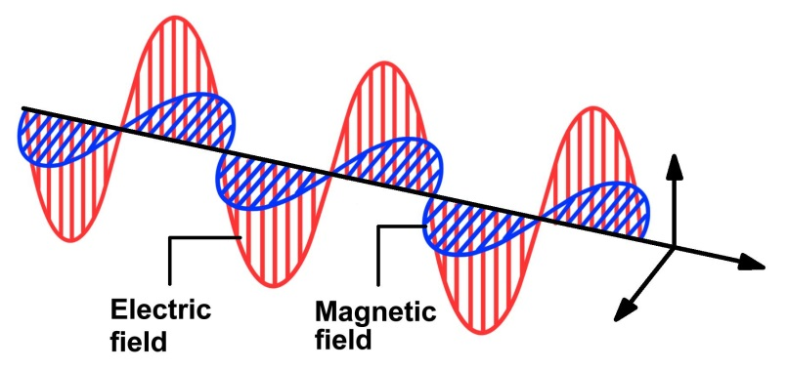
Microwaves
Microwaves are electromagnetic waves
300MHz-
300Ghz
Frequency range
Microwaves is the shortest wavelength region of the radio spectrum and a part of the electromagnetic spectrum
100cm-
1mm
Wavelengths range in air
The word microwave means “very short wave”

Slide 8
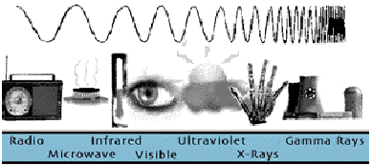
What are Microwaves? (Pozar Sec. 1.1)
Microwaves: 30 cm – 1 cm
(centimeter waves)
λ = 30 cm: f = 3 x 10⁸/ 30 x 10⁻² = 1 GHz
λ = 1 cm: f = 3 x 10⁸/ 1x 10⁻² = 30 GHz
Note: 1 Giga = 10⁹
Millimeter waves: 10 mm – 1 mm
λ = 10 mm: f = 3 x 10⁸/ 10 x 10⁻³ = 30 GHz
λ = 1 mm: f = 3 x 10⁸/ 1x 10⁻³ = 300 GHz

Slide 9
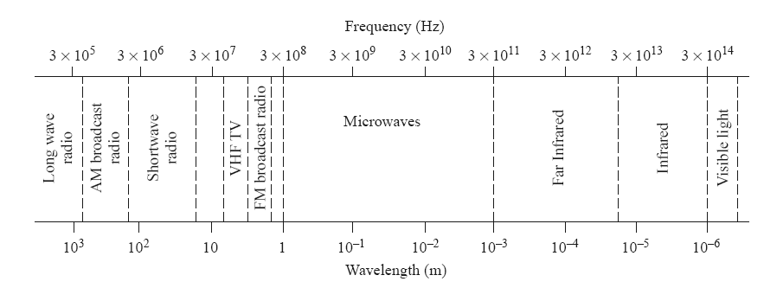
Frequency Band

Slide 10
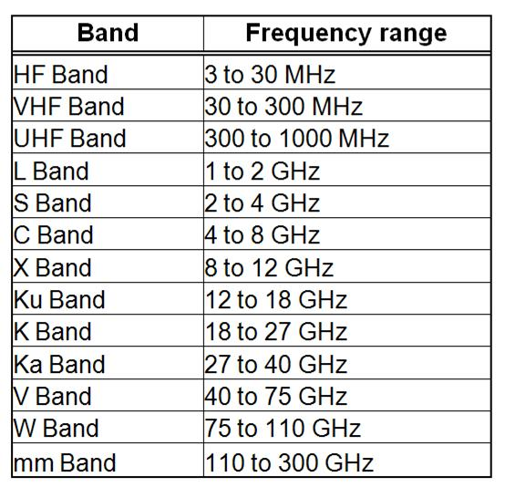
Microwaves Frequency Bands

Slide 11
Properties of Microwaves
1.Electromagnetic radiation of short wavelength
2.Can reflect by conducting surface like optical waves.
3.M.W current flows through outer layer of conductor
4.Microwaves are easily attenuated
5.They are not reflected by ionosphere

Slide 12
Advantages and Limitations
Microwaves have large bandwidths
Improved Directive properties.Can be focused in a specified direction
Fading effect and reliability.
Due to LOS and high frequency fading effect is very low
Transmitter/Receiver power requirements are pretty low at microwave frequencies
Notes:
-Fading effect is nothing but the fluctuation in received signal strength at the receiver

Slide 13
Advantages and Limitations
Microwave band ranging from 300MHz-10GHz are capable of freely propagating through atmosphere
This helps in astronomical research of space in the study of microwave radiations from the sun and stars

Slide 14
Advantages of Microwave communication
High bandwidth,higher speeds
Because of high frequency, more data can be sent.
Smaller antennas produce a more focused beam
Because of their short wavelength,microwaves use smaller antennas
Notes:
-work by startup Dockon on innovative antennas that use both the transverse electric (TE) and transverse magnetic (TM) modes of the antenna to achieve high gain, high efficiency (often more than 90 percent), and even broad bandwidth in designs that are 13 x 11 mm or less for 2.4-to-2.5-GHz use.

Slide 15
Disadvantages of microwave communication
They require no obstacle is present in the transmission path
The cost of implementing the communication infrastructure is
high
Microwaves are susceptible to rain,snow,electromagnetic interference

